Slide 1


Slide 2
Regression and Classification

Slide 3
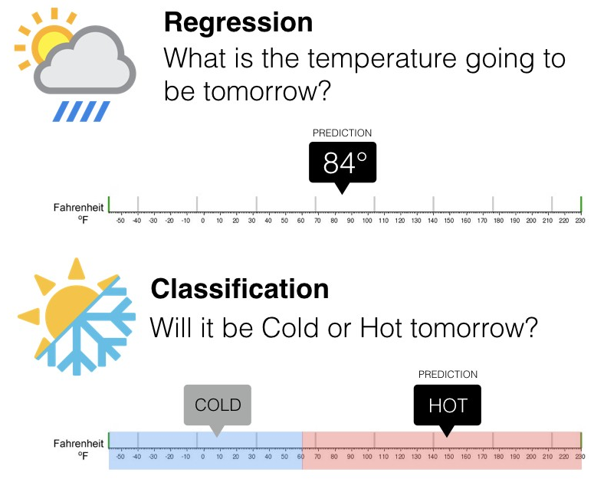

Slide 4
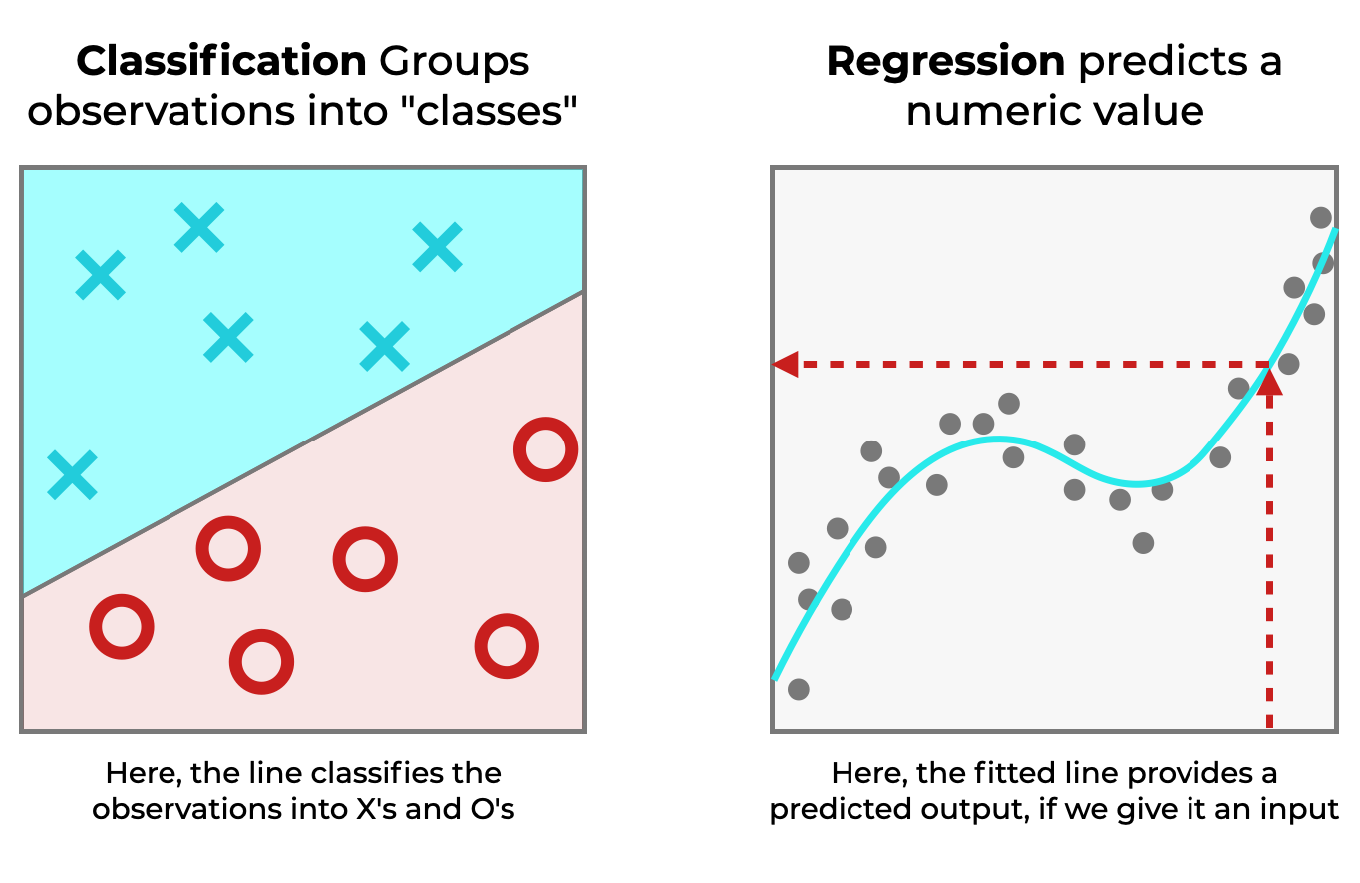

Slide 5
Linear Regression
relationship between a dependent (output variables) variable and one or more independent (feature variable) variables using a straight line.

Slide 6
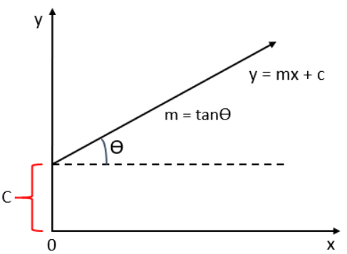
Linear Regression
This straight line is represented using the following formula:
y = mx +c
Where,
y: dependent variable
x: independent variable
m: Slope of the line
c: y intercept

Slide 7
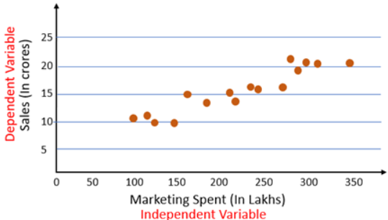
Linear Regression
Correlation coefficient and scatter plot

Slide 8
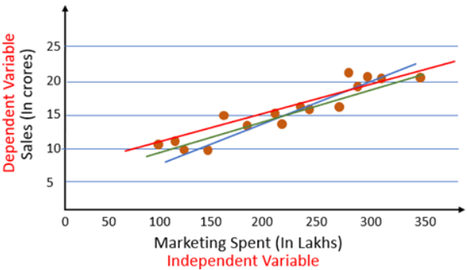
Linear Regression
how do we know which of these lines is the best fit line?

Slide 9
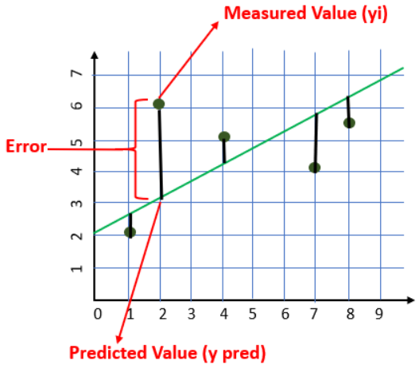
Cost Function
The cost is the error in our predicted value.
We will use the Mean Squared Error function to calculate the cost.

Slide 10
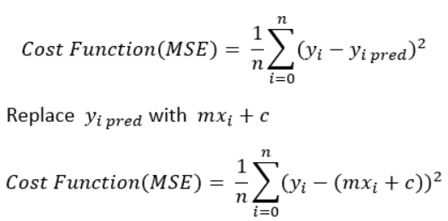
Cost Function

Slide 11
Gradient Descent
Error Optimization
Algorithm

Slide 12
Gradient Descent

Slide 13
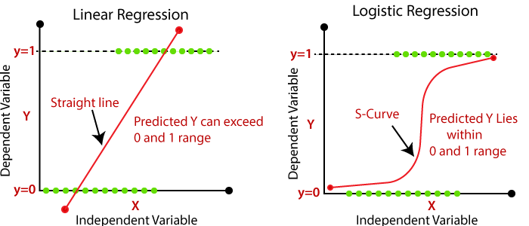
Logistic Regression

Slide 14
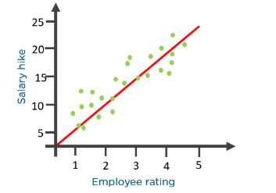
Logistic Regression
An organization wants to determine an employee’s salary increase based on their performance.
what if the organization wants to know whether an employee would get a promotion or not based on their performance?

Slide 15
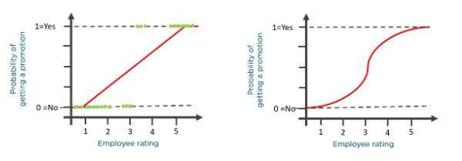
Logistic Regression
What if the organization wants to know whether an employee would get a promotion or not based on their performance?

Slide 16
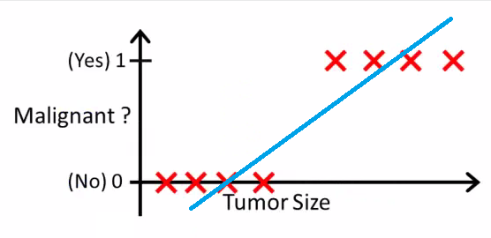
Why Logistic Regression

Slide 17
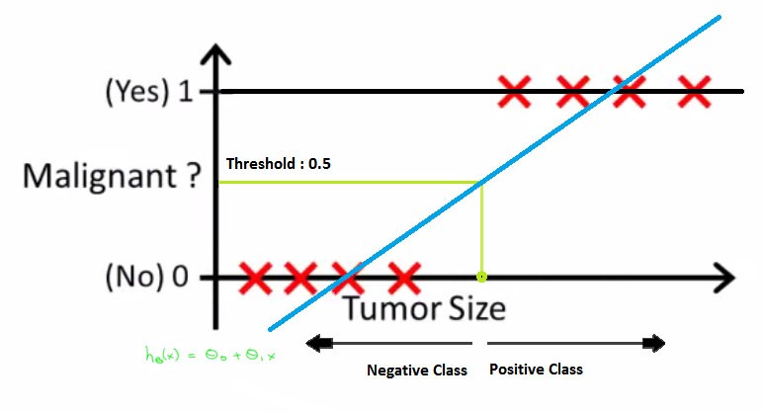
Why Logistic Regression

Slide 18
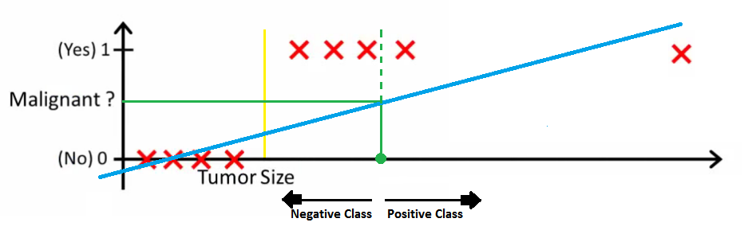
Why Logistic Regression
Problem occurs when there is an Outlier

Slide 19
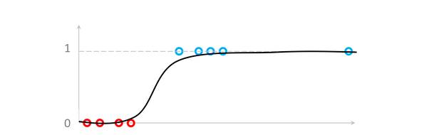

Why Logistic Regression
To solve this issue Sigmoid Function is used
Map any real value between 0 and 1.

Slide 20
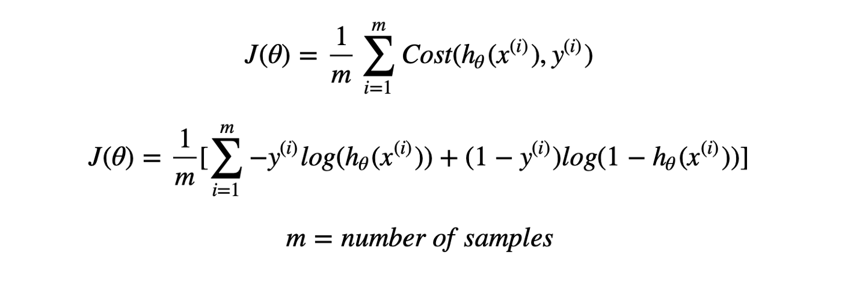
Why named Logistic ?

Slide 21
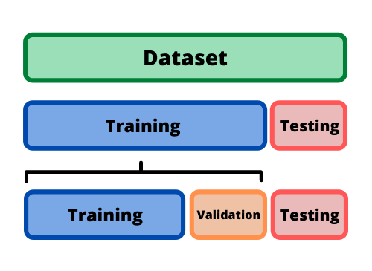
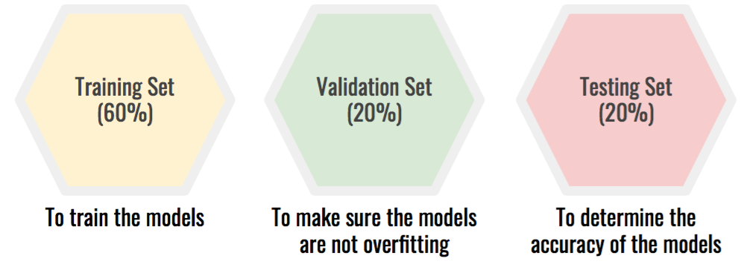
Model Building and Evaluation

Slide 22
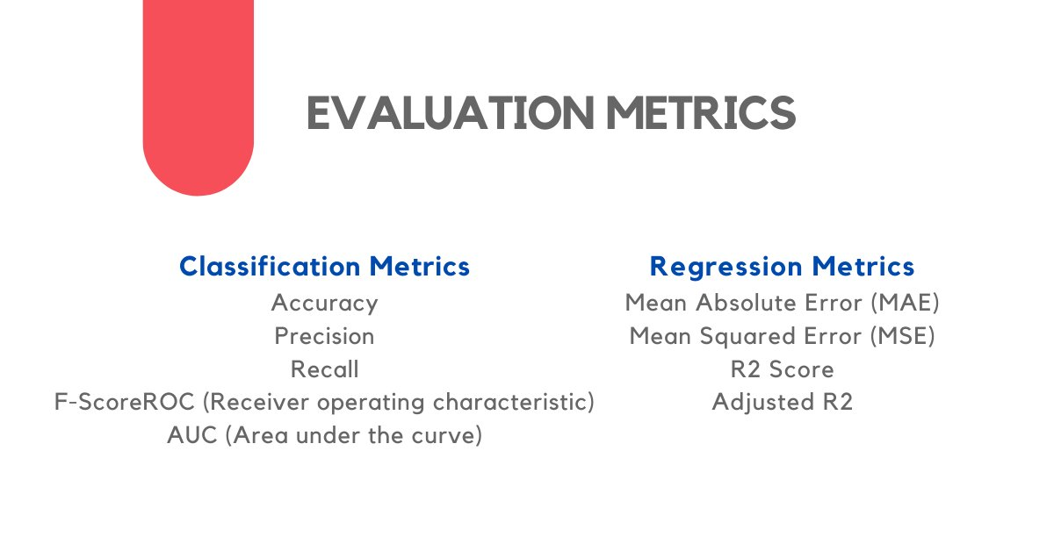
Model Building and Evaluation

Slide 23
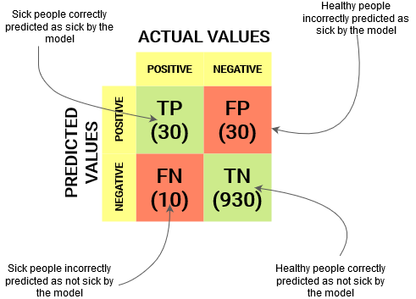
Model Building and Evaluation

Slide 24
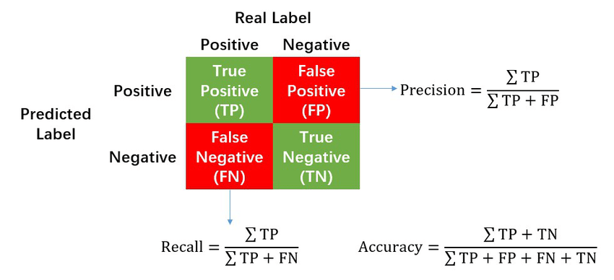
Model Building and Evaluation

Slide 25
Model Interpretation
??

Slide 26


